Slide 1



On disseminating research results: essentials of effective publishing
Witold Pedrycz, PhD, DSci, Fellow (IEEE)
University of Alberta, Edmonton, Canada
and
Systems Research Institute, Polish Academy of Sciences, Warsaw, Poland
Hong Kong PolyU January 5, 2011

Slide 2
Agenda
Writing a quality manuscript
    Preparation
    Constructing the paper
    Language
    Technical details
Revisions and response to reviewers
Ethical issues
Conclusions

Slide 3


Slide 4

Information Sciences

Slide 5
Writing a quality manuscript
Preparation

Slide 6
Preparation
Originality
Key objectives
Nature of study (fundamental, experimental, case study, etc.)
Possible submission vis-à-vis scope of journal

Slide 7
Writing a quality manuscript
Article construction

Slide 8
Article structure
Title
Authors
Abstract
Keywords
Main text
  Introduction
  Methods
  Results
  Discussion (Conclusion)
Acknowledgements
References
Supplementary material (optional)
Need to be accurate and informative for effective indexing and searching
Each has a distinct function

Slide 9
Title
A good title should contain the fewest possible words that adequately describe the contents of a paper
DO
Convey main findings of research
Be specific
Be concise
Be complete
Attract readers

Slide 10
Title
A good title should contain the fewest possible words that adequately describe the contents of a paper
DON’T
Use unnecessary jargon
Use uncommon abbreviations
Use ambiguous terms
Use unnecessary detail
Focus on part of the content only

Slide 11
Title
Slower learning in multilayer neural networks is correlated with numerous inputs of diversified ranges, high level of noise, and nonstationary
nature of data
Relationships between data preprocessing and learning in multilayer neural networks

Slide 12
Authors and affiliations
Be consistent with spelling, full versus short names, full versus short addresses
Surnames:
Middle Initial: Use consistently or not at all
First Names: e.g., Mike/ Michael
Affiliation:

Slide 13
Abstract
Types:
  Indicative (descriptive) abstracts outline the topics covered in a piece of writing so the reader can decide whether or not to read on. Often used in review articles and conference reports
  Informative abstracts summarize the article based on the structure, but without section headings
  Structured abstracts follow headings required by the journal. Often used in medical journals
Check carefully which type fits the journal of your choice

Slide 14
Abstract
The quality of an abstract strongly impacts the editor’s decision
A good abstract:
Is precise and honest
Stand alone entity
Uses no technical jargon
Is brief and specific
Cites no references

Slide 15
Keywords
Keywords are important for indexing: they enable your manuscript to be more easily identified and cited
Check the Guide for Authors for journal requirements
Keywords should be specific
Avoid uncommon abbreviations and general terms

Slide 16
Introduction
Provide the necessary background information to put your work into context
It should be clear from the introduction:
Why the current work was performed
    aims
    significance
What has been done before
What was done (in brief terms)
What was achieved (in brief terms)

Slide 17
Introduction
DO
Consult the Guide for Authors for word limit
“Set the scene”
Outline “the problem” and hypotheses
Ensure that the literature cited is balanced, up to date and relevant
Define any non-standard abbreviations and jargon

Slide 18
Introduction
DON’T
Write an extensive review of the field
Cite disproportionately your own work, work of colleagues or work that supports your findings while ignoring contradictory studies or work by competitors
Describe methods, results or conclusions other than to outline what was done and achieved in the final paragraph
Overuse terms like “novel” , “highly original” and “for the first time”

Slide 19
Mathematics
Avoid “dry” formulas; explain them
Explain all symbols before using them
Avoid misuse of symbols
Use standard notation (say, vectors)

Slide 20
Results
The main findings of the research
DO
Use figures and tables to summarize data
Show the results of statistical analysis
Compare “like with like”

Slide 21
Results
The main findings of the research
DON’T
Duplicate data among tables, figures and text
Use graphics to illustrate data that can easily be summarized with text

Slide 22
Graphics
Figures and tables are the most effective way to present results
BUT:
Captions should be able to stand alone, such that the figures and tables are understandable without the need to read the entire manuscript
The data represented should be easy to interpret
Colours should only be used when necessary; not to be overused

Slide 23
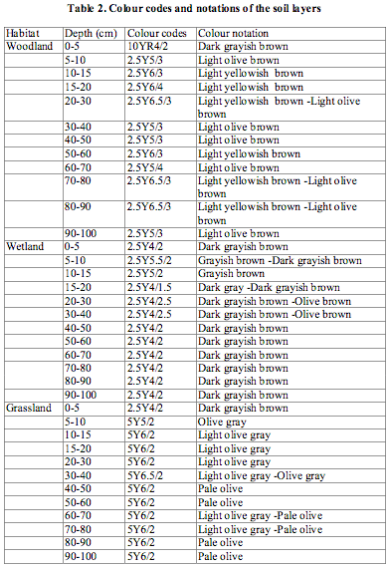
Graphics
Illustrations should only be used to present essential data
The information in the table can be presented in one sentence:
‘The surface soils were dark grayish brown, grading to light olive brown (woodland), light olive brown (wetland), and pale olive (grassland) at 100 cm.’
Summarize results in the text where possible

Slide 24
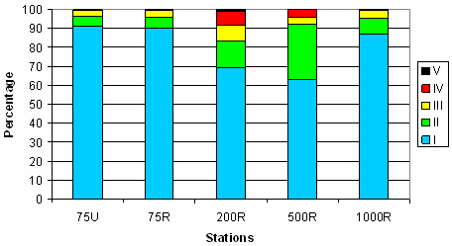
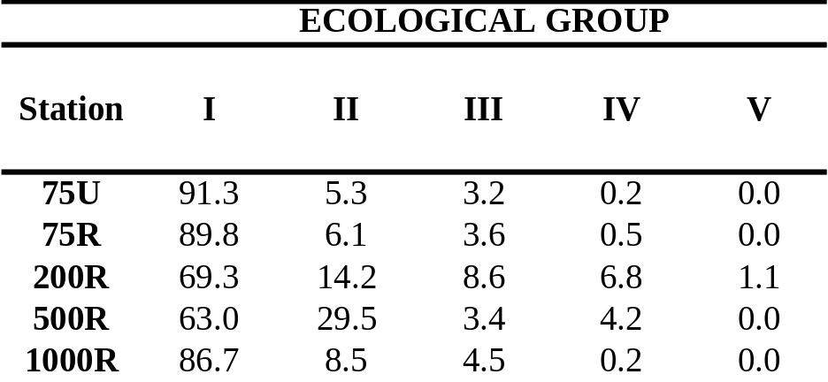
Graphics
The figure and table show the same information, but the table is more direct and clear

Slide 25
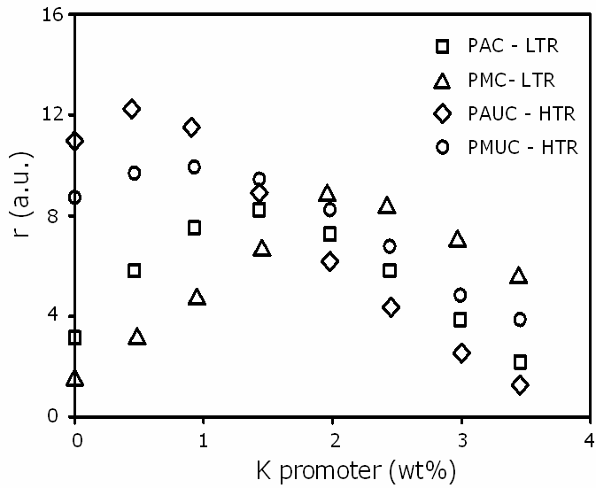
Graphics
Poor
Legend is poorly defined
Graph contains too much data
No trend lines

Slide 26
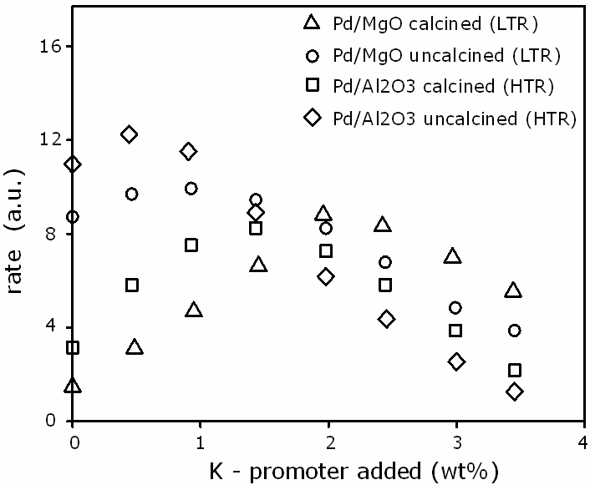
Graphics
Better
Legend is well defined but there is still too much data and no trendlines

Slide 27
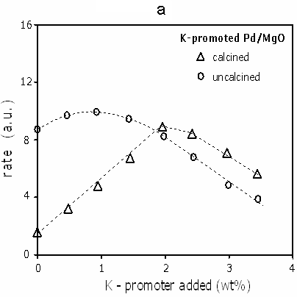
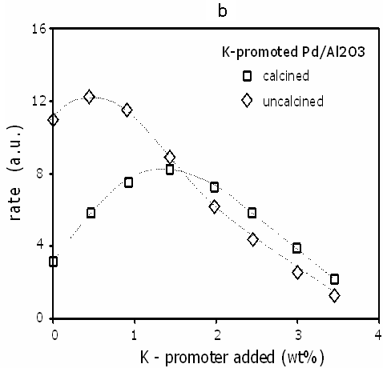
Graphics
Best
Legend is clear
Data is better organized
Trend lines are present

Slide 28
Graphics

Slide 29
Statistics
Indicate the statistical tests used with all relevant parameters
mean ± SD
Give numerator and denominators with percentages
40% (100/250)
Use means and standard deviations to report normally distributed data

Slide 30
Statistics
Use medians and interpercentile ranges to report skewed data
Report P values
p=0.0035 rather than p<0.05
The word “significant” should only be used to describe “statistically significant differences”

Slide 31
Statistics
Make your experimental findings meaningful and convincing…
Be explicit
Experiments need to be reproducible (well-documented data,
details of experiments provided)
Training – testing data
10-fold cross-validation

Slide 32
Discussion
Describe
How the results relate to the study’s aims and hypotheses
How the findings relate to those of other studies
All possible interpretations of your findings
Limitations of the study

Slide 33
Discussion
Avoid
Making “grand statements” that are not supported by the data
  Example: “This novel optimization method will enormously reduce the learning time”
Introducing new results or terms

Slide 34
Conclusion
Put your study into CONTEXT
Describe how it represents an advance in the field
Suggest future experiments
BUT
Avoid repetition with other sections
Avoid being overly speculative
Do not over-emphasize the impact of your study

Slide 35
Acknowledgements
Acknowledge anyone who has helped you with the study, including:
  Researchers who supplied materials or software,
  Anyone who helped with the writing or English, or offered critical comments about the content
  Anyone who provided technical help
State why people have been acknowledged and ask their permission
Acknowledge sources of funding, including any grant or reference numbers

Slide 36
References
Check the Guide for Authors for the correct format
Check
Spelling of author names
Punctuation
Number of authors to include before using “et al.”
Reference style

Slide 37
References
Check the Guide for Authors for the correct format
Avoid
Personal communications, unpublished observations and submitted manuscripts not yet accepted
Outdated papers
Citing articles published only in the local language
Excessive self-citation and journal self-citation

Slide 38
References
Check the style and format as required – it is not the editor’s job to do so for you
Harvard System (alphabetical by author/date)
APA (American Psychological Association) System (alphabetical)
Vancouver System (numbered in order or citation)
Note: there are a number of other systems in use and variations for all systems

Slide 39
Supplementary material
Information related to and supportive of the main text, but of secondary importance
Data
Code
Video data
Will be made available online when the manuscript is published

Slide 40
Writing a quality manuscript
Language

Slide 41
The three “C”s (C³) principle
Good writing possesses the following three “C”s:
Clarity
Conciseness
Correctness (accuracy)
The key is to be as brief and specific as possible without omitting essential details

Slide 42
Common traps
Good writing avoids the following traps:
Repetition
Redundancy
Ambiguity
Exaggeration
These are common annoyances for editors

Slide 43
Repetition and redundancy
Vary the sentences used when writing the abstract or describing findings at the end of the introduction
Don’t copy from other sections verbatim!
Avoid words with the same meaning
In addition, there were also modifications to the learning rule dealing with…

Slide 44
Ambiguity
Compare apples to apples…
The results produced by the fuzzy model are compared with several neural networks

Slide 45
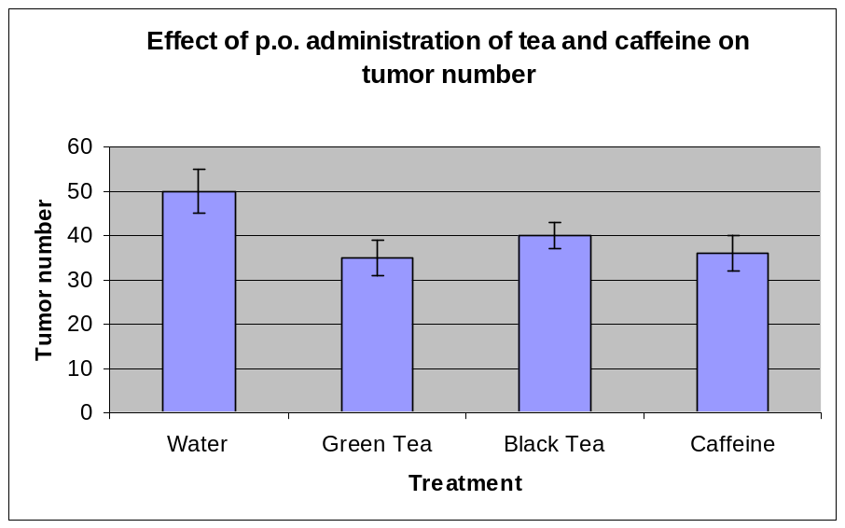
Exaggeration
*
“There was a massive decrease in the number of tumors following p.o. administration of green tea”
Beware of exaggeration but do indicate significance

Slide 46
Exaggeration
*
“There was a massive decrease in the number of tumors following p.o. administration of green tea”
Beware of exaggeration but do indicate significance

Slide 47
Other common traps
Incorrect use of etc. / and so on
“The two groups of data were compared using a variety of statistical methods including a t-test, chi squared analysis, etc.”
It is important here to define the tests used as they are particular to the paper, not part of a natural series and not obvious to the reader

Slide 48
Language Editing Services
Your manuscript is precious, invest in it
Specialist scientific and engineering editing services are commercially available to polish the language in your manuscript prior to journal submission

Slide 49
Writing a quality manuscript
Technical details

Slide 50
Layout
Keep line spacing, font and font size consistent throughout – double-spaced 12-point Times New Roman is preferred
Use consistent heading styles throughout and no more than three levels of heading
Number the pages
Number lines if journal requires – check the Guide for Authors
Order and title sections as instructed in the Guide for Authors – Figure and Table sections are normally together following References

Slide 51
Length
Consult the Guide for Authors for word and graphic limits
Check available categories: full paper, brief paper, communication
Letters or short communications have stricter limits on the length. For example, 3,000 words with no more than five illustrations.

Slide 52
Abbreviations
Define non-standard abbreviations on first use in both the abstract and the main text
Check the Guide for Authors for a list of standard abbreviations that don’t need defining
Don’t abbreviate terms used only once or twice in the entire manuscript – spell these out in full
Acronyms: capitals not required in the definition unless a proper noun or start of a sentence

Slide 53
Cover letter
This is your chance to speak to the editor directly
Keep it brief, but convey the particular importance of your manuscript to the journal
Suggest potential reviewers
This is your opportunity to convince the journal editor that they should publish your study, so it is worth investing time at this stage

Slide 54
Revisions and
Response to Reviewers

Slide 55
Final checks
Revision before submission can prevent early rejection
What can I do to ensure my paper is in the best possible state prior to submission?
Ask colleagues to take a look and be critical
Check that everything meets the requirements set out in the Guide for Authors – again!
Check that the scope of the paper is appropriate for the selected journal – change journal rather than submit inappropriately

Slide 56
Final checks
Revision before submission can prevent early rejection
What can I do to ensure my paper is in the best possible state prior to submission?
If necessary, get a colleague or approved editing service to improve the language and ensure that the manuscript adheres to the requirements
Ensure that the literature cited is balanced and that the aims and purpose of the study, and the significance of the results, are clear
Use a spellchecker

Slide 57
Manuscript submission: milestones
decision
decision
review
review
submission
of revision
submission
of final
version
submission

Slide 58
Post-referee revision
Carefully study the reviewers’ comments and prepare a detailed letter of response
Respond to all points; even if you disagree with a reviewer, provide a polite, scientifically solid rebuttal rather than ignore their comment
Provide page and line numbers when referring to revisions made in the manuscript
Perform additional calculations, computations, or experiments if required; these usually serve to make the final paper stronger

Slide 59
Post-referee revision
The reviewer is clearly ignorant of the work of ….
Thank you for your comment. However, we feel that the assumption in our model is supported by recent work by …

Slide 60
Post-referee revision
State specifically what changes you have made to address the reviewers’ comments, mentioning the page and line numbers where changes have been made
Avoid repeating the same response over and over; if a similar comment is made by multiple people explain your position once and refer back to your earlier response in responses to other reviewers or the editor

Slide 61
Accepting rejection
Don’t take it personally!
Try to understand why the paper has been rejected
Evaluate honestly – will your paper meet the journal’s requirements with the addition of more data or is another journal more appropriate?
Don’t resubmit elsewhere without significant revisions addressing the reasons for rejection and checking the new Guide for Authors

Slide 62
Accepting rejection
Suggested strategy for submitting elsewhere:
In your cover letter, declare that the paper was rejected and name the journal
Include the referees’ reports and show how each comment has been addressed
Explain why you are submitting the paper to this journal; is there a more appropriate journal?

Slide 63
Ethical Issues

Slide 64
Ethical Issues
http://www.ieee.org/web/publications/rights/plagiarism_FAQ.html

Slide 65
Unethical behavior includes:
Multiple submissions
Redundant publications
Plagiarism
Data fabrication and falsification
Improper use of human subjects and animals in research
Improper author contribution

Slide 66
Multiple submissions
Multiple submissions save your time but waste editors’
The editorial process of your manuscripts will be completely stopped if the duplicated submissions are discovered

Slide 67
Multiple submissions
Competing journals constantly exchange information on suspicious papers
You should not send your manuscripts to a second journal UNTIL you receive the final decision from the first journal
DON’T DO IT!!

Slide 68
Redundant publication
An author should not submit for consideration in another journal a previously published paper
  Published studies do not need to be repeated unless further confirmation is required
  Previous publication of an abstract during the proceedings of conferences may not preclude subsequent submission for publication, but full disclosure should be made at the time of submission

Slide 69
Plagiarism
“Plagiarism is the appropriation of another person’s ideas, processes, results, or words without giving appropriate credit, including those obtained through confidential review of others’ research proposals and manuscripts”
Federal Office of Science and Technology Policy, 1999

Slide 70
Plagiarism
Plagiarism is a serious offence that could lead to paper rejection, academic charges and termination of employment. It will seriously affect your scientific reputation
DON’T DO IT!
Unacceptable paraphrasing, even with correct citation, is considered plagiarism

Slide 71
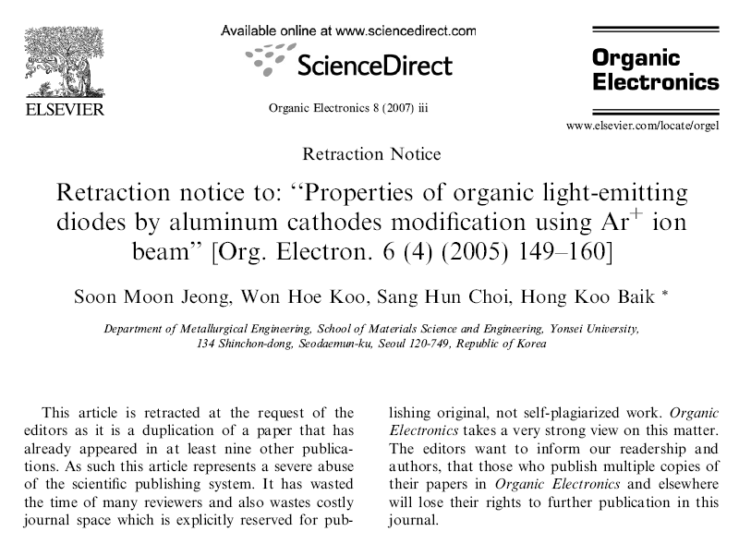

Slide 72
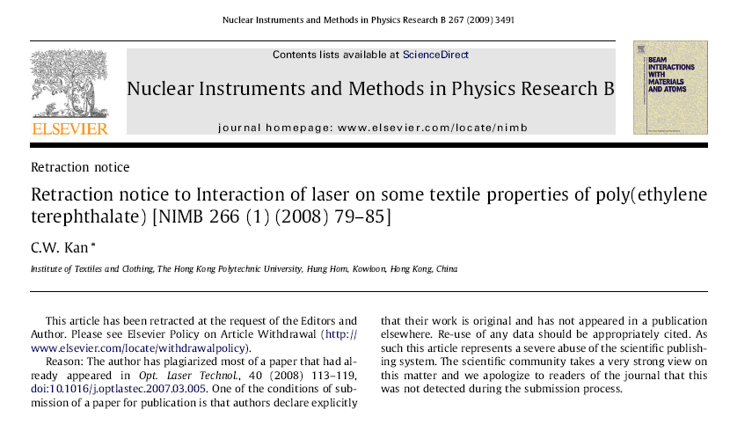

Slide 73
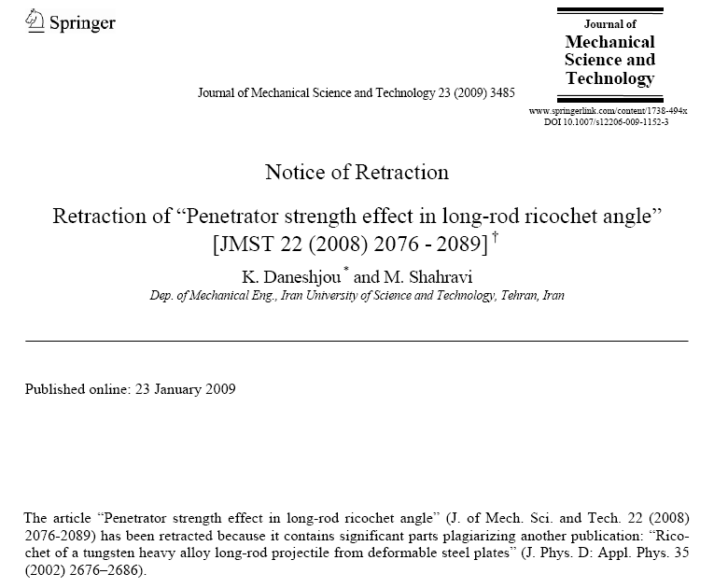

Slide 74
Plagiarism-levels
Uncredited verbatim copying of a full paper or verbatim copying
within more than one paper by the same author(s)
Uncredited verbatim copying of large portion (20-50%) or verbatim copying
within more than one paper by the same author(s)
Uncredited verbatim copying of individual elements (paragraphs, sentences,
illustrations) resulting in a significant portion (up to 20%) within a paper
Uncredited improper paraphrasing of pages or paragraphs
Credited verbatim copying of a major portion of a paper without clear
delineation (quotes or indents)

Slide 75
Plagiarism-corrective actions
Notice of violation in Xplore
Prohibition from publishing in IEEE periodicals
Rejection and return of papers in reviews and queues
Referral to the IEEE Ethics and Member Conduct Committee

Slide 76
Data fabrication and falsification
Fabrication is making up data or results, and recording or reporting them
Falsification is manipulating research materials, equipment, processes; or changing / omitting data or results such that the research is not accurately represented in the research record

Slide 77
Unethical research
Experiments on human subjects or animals should follow related ethical standards, namely, the Helsinki Declaration of 1975, as revised in 2000 (5)
If doubt exists concerning the compliance of the research with the Helsinki Declaration, authors must explain the rationale for their approach and demonstrate approval from the institutional review body

Slide 78
Conclusion: Getting Accepted

